Slide 1

AI Ops with LLM Automating BP Support activities – A POV
Ashish Easow
* Assistant – ChatGPT

Slide 2

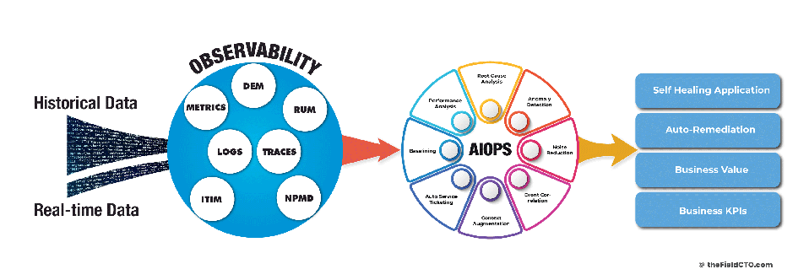
AI Ops

Slide 3



The Design
Prompts
1. Send metrics/logs/Queue data to LLM for observation/action
Application Errors/Logs
2. Prompt to add action for any analysis
LLM
RPA/BP
Structured response
Actions

Slide 4

Conclusion
Notes:
Similar to a RAG architecture, which acts as guardrails to provide data to LLM, in this case Blueprism provides both the data from the exceptions as well as prompts which have details on the actions to be taken.
BP further goes ahead and acts has the hands and feet for the LLM to take actions based on the response obtained, these can be as simple as programmatic retries and restarts or can be further developed based on the capabilities of the LLM.
All in all we can see that it provides a significant boost to automating the task of support functions.
It depends on the LLM being chosen too
Gemini e.g.

Slide 5


Thank You
GIT Repo: https://github.com/ashz30/AIOpsWithLLM
Linkedin: https://www.linkedin.com/in/ashz30/
Youtube : https://www.youtube.com/@ashz31

